Slide 1
Deployment
An Introduction

Slide 2
An Important Distinction
Development Environment:
The hardware and software that are used to (design and) implement a software product
Testing Environment:
The hardware and software that are used to test (usually integration testing and system testing) a software product
Production Environment:
The hardware and software system that the user interacts with through the software product

Slide 3
Physical Architectures
Definition:
A physical architecture is a realization of a software product as artifacts (e.g., files) residing on and executing on computational resources
An Important Note:
A product's physical architecture is distinct from its logical architecture (i.e., the software's major components and the relationships between them)

Slide 4
Characteristics of Physical Architectures
Where is the software installed?:
Local device
Central device(s)
Hybrid
Where is the software executed?
Local device
Central device(s)
Hybrid
Where are user configurations and data stored?
Local device
Central device(s)
Hybrid

Slide 5
Archetypical Physical Architectures
The Rare Archetypes:
Mobile Agents - The software is stored on the user device and executed on the shared device (using data from one or the other)
The software is stored and executed on one device (either the user device or the shared device) but the user data is stored on another

Slide 6
Archetypical Physical Architectures
Personal:
The software product is "permanently" installed on the user's device (e.g., personal computer, phone, tablet) and executes on that device's processor
If the device has multiple users, configuration information and user data are associated with each user
Shared:
The software product is "permanently" installed on a shared storage device but executes on the user device's processor
Configuration information for each user and user data are stored on the user's device

Slide 7
Archetypical Physical Architectures (cont.)
Mainframe:
The software product is installed on and executes on a central device, and is accessed from the user's device (which behaves as a generic "terminal")
Configuration information for each user and user data is stored on the central device
Cloud:
The software product is temporarily delivered to the user's device and executes on that device's processor (e.g., applets, WWW apps)
Configuration information for each user and user data is (mostly) stored "in the cloud"

Slide 8
Archetypical Physical Architectures (cont.)
The Hybrid Architectures:
Some components of the system (e.g., classes) may be stored/executed on one device while others might be stored executed on another
Some data may be one one device and some data may be on another
Some Important Examples:
A product with a logical client-server architecture in which the client is on the user's device and the server is on a central device
A product with sensitive/personal data stored on the user's device and common data stored on a central device

Slide 9
Activities in the Deployment Process
Release:
Prepare the product for the subsequent steps (i.e., assemble the parts/resources/artifacts and create a distributable package)
Install:
Transfer the product from the development environment to the production environment
Activate:
Start all of the executable components
Deactivate:
Stop the executable components
Uninstall:
Remove the product from the production environment

Slide 10
Some Complications to the "Pure" Process
Need for Updates:
Replace either a part of or all of an installed product (which may or may not require deactivation and reactivation)
State Changes:
The use of a software product often changes the state of the production environment (e.g., data files, preferences/options)

Slide 11
Requirements of the Process
Atomicity:
Though installation and activation will likely involve multiple parts and happen over time, they must appear to be atomic
Rollback:
It is important to be able to "undo" a deployment activity and return the environment to its previous state

Slide 12
Some Other Issues
Protecting Digital Information:
Copy Protection
Digital Rights Management
Integrity:
Digital Signatures
Distributable Packages:
Installers (e.g., InstallShield, Installer VISE)
"Stores" (e.g., Apple Store, Play Store, Windows Store)
Virtual Machines (e.g., VMWare, VirtualBox)
Containers (e.g., Docker)

Slide 13
UML Deployment Diagrams
An Introduction

Slide 14
UML Deployment Diagrams
Purpose of Deployment Diagrams:
To model a physical architecture
Elements:
Artifacts - a physical manifestation of a component of a software system (e.g., files)
Nodes - computational resources (i.e., a physical device or an execution environment such as a virtual machine)

Slide 15

Visual Representation of Artifacts
General Representation:
Iconic Representation:
An icon that represents the type of the artifact

Slide 16
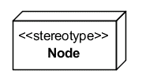
Visual Representation of Nodes
In General:
Common Stereotypes:
<<device>>
<<execution environment>>
A description of the computational resource

Slide 17
Visual Representation of Relationships
Communication Paths:
A solid line between nodes
Deployment:
An artifact can be placed in a node
A node can contain a list of artifact names
A dependency arrow (with the stereotype <<deploy>>) can connect the artifact to the node

Slide 18
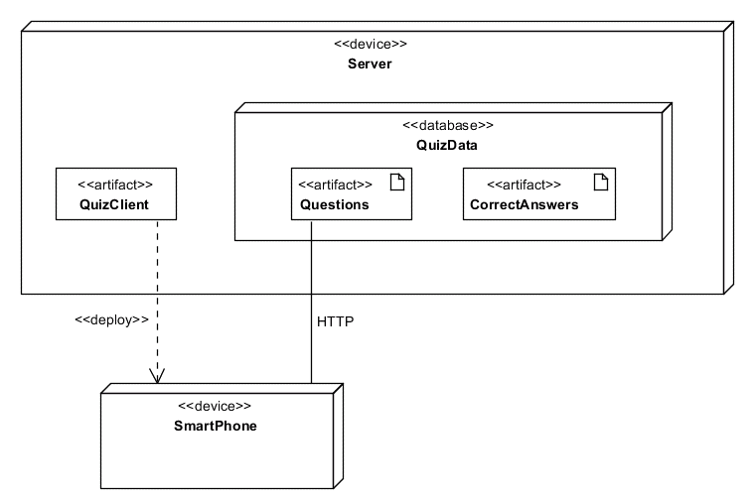
An Example

Slide 19
Support
An Introduction

Slide 20
What Is Support?
A Narrow View:
Interaction between a stakeholder and another person for the purpose of improving the stakeholder's experience
What About User Documentation?
Some people include it in support
We will view it as an alternative to support

Slide 21
Types of Support
Professional:
The person interacting with the stakeholder is employed by (either directly or indirectly) the provider of the software product
Community:
The person interacting with the stakeholder is another stakeholder (or has appropriate expertise for other reasons)
Hybrid:
A community system in which the professionals participate

Slide 22
Methods of Providing/Delivering Support
Channel:
Telephone
Electronic Mail
Chat/Messaging
Social Network
WWW "Forms"
Interaction:
Synchronous
Asynchronous

Slide 23
Support Tracking/Management
Purpose:
Accept, prioritize, assign, track, and log requests for support
Common Terminology:
Call Management System
Ticketing System

Slide 24
Support Arrangements/Contracts
Free:
The stakeholder is not charged for support services
Fee-Based:
Per "Call"
Time and Materials
Block of Hours
Unlimited
Managed Services

Slide 25
Levels/Tiers of Support
The Concept:
Provide different levels of support services to different stakeholders (usually for different fees)
Defining Tiers:
Hours of Support (e.g., 24/7, M-F)
Time to Engage (e.g., within 5 minutes, same-day)
Priority/Severity of the Request

Slide 26
Designing/Implementing with Support in Mind
Motivation:
Users often do not have the technical expertise necessary to explain their situation so it can help if the product itself can help
Support-Oriented Features:
Remote Control
Logging/Diagnostics

Slide 27
Maintenance
An Introduction

Slide 28
Types of Maintenance (ISO/IEC 14764)
Corrective:
Modifications that correct defects found in the production environment
Preventive:
Modifications that correct faults discovered in the development environment before they give rise to failures/symptoms in the production environment
Adaptive:
Modifications that keep the product usable in a changed/changing production environment (e.g., migration to another platform)
Perfective:
Modifications that satisfy additional functional requirements (e.g., new features) or non-functional requirements (e.g., improve performance)

Slide 29
Frequency
Agile Processes:
Tend to deploy more frequently
So, maintenance activities tend to occur more frequently
Heavyweight Processes:
Less frequent
No less significant

Slide 30
The Results of Several Surveys
Adaptive and Perfective:
75% of the total effort and cost
Corrective and Preventive:
25% of the total effort and cost

Slide 31
Why Maintenance is Expensive
Endemic Reasons:
Successful products are in the field for decades so huge costs are bound to accrue
Other Reasons:
Much software is poorly written
As a product is modified its structure deteriorates
Notes:
Section 1

Slide 32
Maintenance Tradeoffs
Related to Availability:
Maintenance improves a product but may make it unavailable
Related to Quality:
There are often "elegant" solutions and "quick and dirty" solutions

Slide 33
Who Is Involved?
There Are Options:
The original development team
A maintenance team
More Tradeoffs:
The development team understand the product but may not understand the operational environment
Maintenance teams and development teams may have (or think they have) different statuses

Slide 34
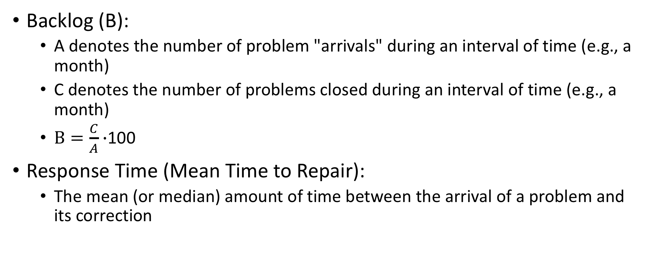
Metrics for Corrective Maintenance

Slide 35
Tools for Corrective Maintenance (i.e., Bug/Issue Tracking)
Purpose:
Provide a clear, centralized overview of corrective maintenance requests
Calculate performance metrics
Some Open Source Examples:
Apache Bloodhound
Bugzilla
Zentrack

